Slide 1

Product Wiki …a single stop for product info
Project Name : Pearson Qglobal
Author : Sharmistha

Slide 2

Product Wiki …a single stop for product info
The Q Global platform has experienced a rapid growth in a short amount of time. This expansion of products, platform features, localization, customer-data load, and customer-user load has brought new challenges to our team. One of the challenges is making sure the products realease to outerworld is working as expected. To ensure this, we need to track the customer feedback and accordingly we have to remold and reconstruct the product architecture. Everytime we receive any requirement change (majr or minor) or a new functionality, we need to fetch the product informations to identify the scope change and to understand its impact .So we need some arifact which could have helped us in recollecting the required data.
A Prodyct Wiki contains product identification along with its scorability conditions, test item / test response details, available delivery modes , Form and Report types and the Report Structure .New features introduced to any of the assessment or product can be incorporated to the existing document easily with a minimum effort requirement to keep it up to date .
Benifits of creating a Product Wiki :
This enables a single point of reference for any product.
Without much wastage of time one can find any specific information about a product by searching for product details according to its acronymn .
This document helps in creating a backup for all the release products along with the product status .
Each time we get an assessment for retesting or reverification we need to search for the PDD and the latest version of it.This consumes time.By help of this artifact we can reduce the search time.
This helps in gaining knowledge about an assessment created till date and also helps a new user to understand the assessment usage.
This can be a database for searching the assessments according to any specific feature or characteristic which helps in testing the required fuctionality .
& many more..
1

Slide 3

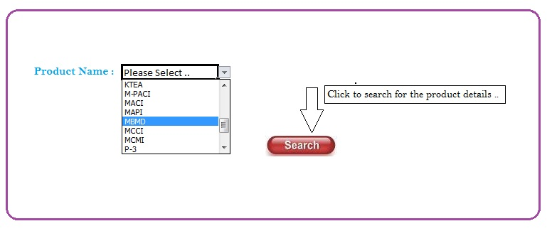
Product Wiki …a single stop for product info
Select an assessment from the available list and click on the Search button to get the details of that product.
2

Slide 4
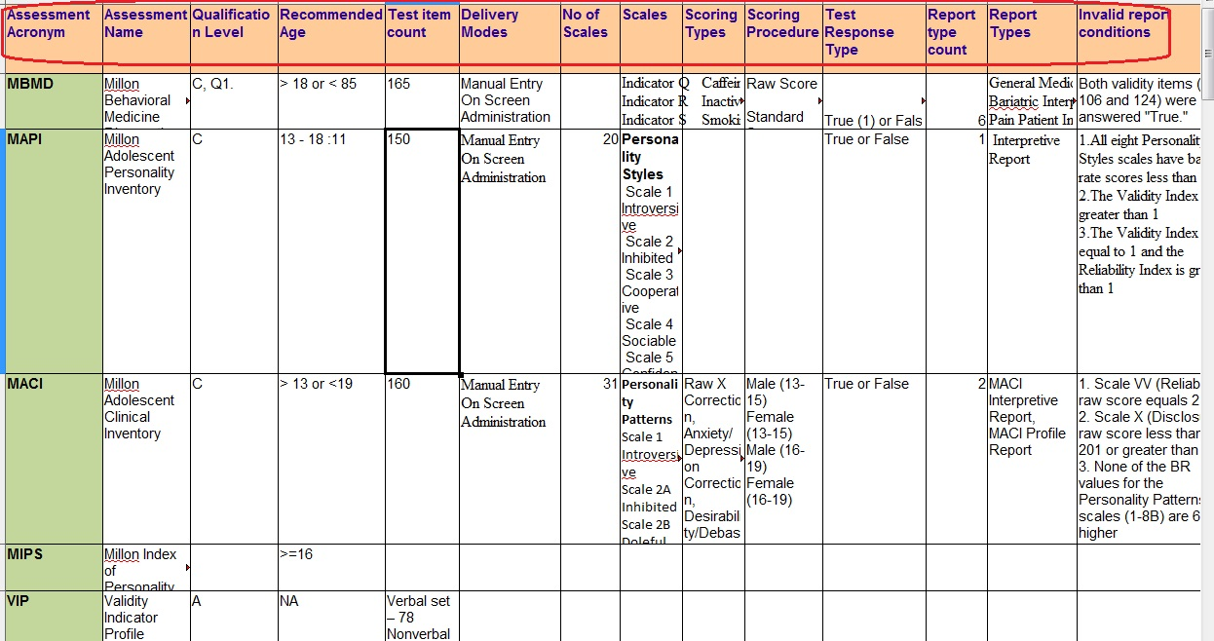
Product Wiki …a single stop for product info
Product details will be stored in an excel and the product details will be shown up according to the selected data.
3

Slide 5
Product Wiki …a single stop for product info
Thank You ...
4

